Slide 1
Database Management Systems (DBMS)
Prof. Saed SAYAd

Slide 2
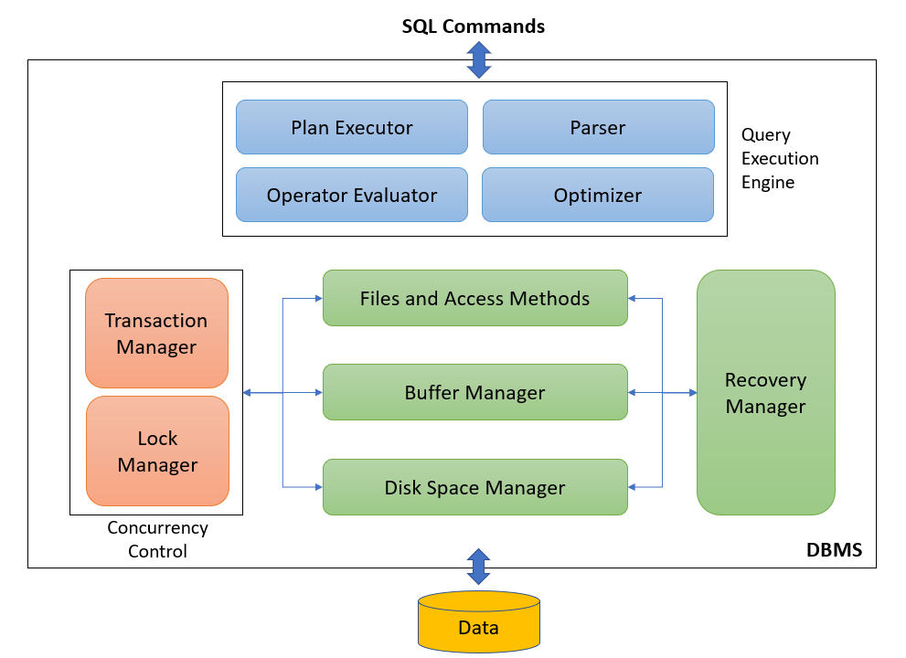
Database Management System

Slide 3
Query Execution
A query plan is a set of steps that the database management system executes in order to complete the query.
The reason we have query plans is that the SQL you write may declare your intentions, but it does not tell SQL the exact logic flow to use.
The query optimizer determines the exact logic flow and the result is the query plan.

Slide 4
Buffer Manager
The buffer manager is the software layer that is responsible for bringing pages from physical disk to main memory as needed.
The buffer manages the available main memory by dividing the main memory into a collection of frames.
The goal of the buffer manager is to ensure that the data requests made by programs are satisfied by copying data from secondary storage devices into buffer.
Data must be in RAM for DBMS to operate on it. Buffer manager hides the fact that not all data is in RAM.

Slide 5
Transactions, Recovery, Concurrency Control
DBMS must support ACID (Atomicity, Consistency, Isolation, Durability) properties
Errors may occur in the DBMS or its environment
Majority of databases are multi-user databases and concurrent access to the same data may induce different types of anomalies

Slide 6
Transactions
Transaction is a set of database operations induced by a single user or application, that should be considered as one undividable unit of work
A transaction is a sequence of reads and writes, e.g., For example, transfer between two bank accounts of the same customer
Transaction always ‘succeeds’ or ‘fails’ in its entirety
Transaction renders database from one consistent state into another consistent state

Slide 7
Transaction Lifecycle
Transactions can be specified implicitly or explicitly
Explicitly: begin_transaction and end_transaction
Implicitly: first executable SQL statement
Once the first operation is executed, the transaction is active
If transaction completed successfully, it can be committed. If not, it needs to be rolled back

Slide 8
ACID vs BASE
All operations in a transaction succeed or every operation is rolled back.
The database appears to work most of the time.
ACID | BASE
Atomicity | Basically Available
Consistency | Soft state
Isolation | Eventual consistency
Durable
Stores do not have to be write-consistent, nor do different replicas have to be mutually consistent all the time.
At the end of the transaction, all data must be left in a consistent state.
Modifications of data performed by a transaction must be independent of another transactions.
The results of applying a transaction are permanent, even in the presence of failures.
Stores exhibit consistency at some later point.

Slide 9
ACID - Example
Atomicity – shouldn’t take money from A without giving it to B
Consistency – money isn’t lost or gained
Isolation – other queries shouldn't see A or B change until transaction is completed or rolled back
Durability – the money does not go back to A is transaction was marked as committed
Transfer $50 from account A to account B:
Read(A)
A-=50
Write(A)
Read(B)
B+=50
Write(B)

Slide 10
Types of Failure & Recovery
Transaction failure results from an error in the logic that drives the transaction’s operations and/or in the application logic
System failure occurs if the operating system or the database system crashes
Media failure occurs if the secondary storage is damaged or inaccessible
Recovery: activity of ensuring that, whichever of the problems occurred, the database is returned to a consistent state without any data loss afterwards

Slide 11
Log File
A unique log sequence number and a unique transaction identifier
A marking to denote the start of a transaction, along with the transaction’s start time and indication whether the transaction is read only or read/write
Identifiers of the database records involved in the transaction, as well as the operation(s) they were subjected to
Before images of all records that participated in the transaction
After images of all records that were changed by the transaction
The current state of the transaction (active, committed or aborted)
Logfile may also contain checkpoints
Write ahead log strategy: all updates are registered on the logfile before written to disk

Slide 12
Concurrency Control
Process of managing simultaneous operations on the database without having them interfere with one another
Purpose of locking is to ensure that, in situations where different concurrent transactions attempt to access the same database object, access is only granted in such a way that no conflicts can occur
A lock is a variable that is associated with a database object, where the variable’s value constrains the types of operations that are allowed to be executed on the object at that time
Lock manager is responsible for granting locks (locking) and releasing locks (unlocking) by applying a locking protocol

Slide 13
Exclusive and Shared Lock
An exclusive lock (x-lock or write lock) means that a single transaction acquires the sole privilege to interact with that specific database object at that time. No other transactions can read or write it.
A shared lock (s-lock or read lock) guarantees that no other transactions will update that same object for as long as the lock is held. Other transactions may hold a shared lock on that same object as well, however they are only allowed to read it.

Slide 14
Lock-based Concurrency control
Strict Two-phase Locking (Strict 2PL) Protocol:
Each transaction must obtain the appropriate lock before accessing an object
All locks held by a transaction are released when the transaction is completed
Growing phase where locks are acquired on resources
Shrinking phase where locks are released

Slide 15
Lock Manager
Lock manager implements locking protocol which is a set of rules to determine what locks can be granted in what situation based on a compatibility matrix.
Current Locks
 | Unlocked | Shared | Exclusive
Unlock |  | yes | yes
Shared | yes | yes | no
Exclusive | yes | no | no
Requested
Locks

Slide 16
Advantages of Database Systems and Database Management
Data Independence
Managing Structured, Semi-Structured and Unstructured Data
Managing Data Redundancy
Specifying Integrity Rules
Concurrency Control
Backup and Recovery Facilities
Data Security
Performance Utilities

Slide 17
Data Independence
Data independence implies that changes in data definitions have minimal to no impact on the applications
Physical data independence implies that neither the applications, nor the views or logical data model must be changed when changes are made to the data storage specifications in the internal data model
Logical data independence implies that software applications are minimally affected by changes in the conceptual or logical data model

Slide 18
Managing Structured, Semi-Structured and Unstructured Data
Structured data
can be described according to a formal logical data model
ability to express integrity rules and enforce correctness of data
also facilitates searching, processing and analyzing the data
E.g., number, name, address and email of a student
Unstructured data
no finer grained components in a file or series of characters that can be interpreted in a meaningful way by a DBMS or application
E.g., document with biographies of famous NY citizens
Semi-structured data
XML data

Slide 19
Managing Data Redundancy
Duplication of data can be desired in distributed environments to improve data retrieval performance
DBMS is now responsible for the management of the redundancy by providing synchronization facilities to safeguard data consistency
Compared to the file approach, the DBMS guarantees correctness of the data without user intervention

Slide 20
Specifying Integrity Rules
Syntactical rules specify how the data should be represented and stored
customerID is an integer; birthdate should be stored as month, day and year
Semantical rules focus on the semantical correctness or meaning of the data
customerID is unique; account balance should be > 0; customer cannot be deleted if he/she has pending invoices
Integrity rules are specified as part of the conceptual\logical data model and stored in the catalog
directly enforced by the DBMS instead of applications

Slide 21
Concurrency Control
DBMS has built in facilities to support concurrent or parallel execution of database programs
Key concept is a database transaction
sequence of read/write operations considered to be an atomic unit in the sense that either all operations are executed or none at all
Read/write operations can be executed at the same time by the DBMS
DBMS should avoid inconsistencies!

Slide 22
DBMS must support ACID
Atomicity requires that a transaction should either be executed in its entirety or not all
Consistency assures that a transaction brings the database from one consistent state to another
Isolation ensures that the effect of concurrent transactions should be the same as if they would have been executed in isolation
Durability ensures that the database changes made by a transaction declared successful can be made permanent under all circumstances

Slide 23
Backup and Recovery Facilities
Backup and recovery facilities can be used to deal with the effect of loss of data due to hardware or network errors, or bugs in system or application software
Backup facilities (e.g., log files) can either perform a full or incremental backup
Recovery facilities allow to restore the data to a previous state after loss or damage occurred

Slide 24
Data Security
Data security can be enforced by the DBMS
Some users have read access, whilst others have write access to the data (role-based functionality)
Data access can be managed via logins and passwords assigned to users or user accounts
Each account has its own authorization rules that can be stored in the catalog

Slide 25
Performance Utilities
Three KPIs of a DBMS are
response time denoting the time elapsed between issuing a database request and the successful termination thereof
throughput rate representing the number of transactions a DBMS can process per unit of time
space utilization referring to the space utilized by the DBMS to store both raw data and metadata
DBMSs come with various types of utilities aimed at improving these KPIs such as:
Utilities to distribute and optimize data storage
Utilities to tune indexes for faster query execution
Utilities to tune queries to improve application performance
Utilities to optimize buffer management

Slide 26
www.pdbmbook.com

